Slide 1

ELRPT Onboarding
September, 2025

Slide 2
Agenda
SCWI History, Purpose and Structure (incl. Co-Chair meetings and webinars)
SCWI Website
ELRPT (RPT6) – Structure, Co-Chairs
Earndualcredits.ca Website
ELRPT Terms of Reference
Funding Categories
Forums and Activities
Types of Dual Credit Courses
OYAP
Invoicing
Contract Changes
Cycle Change Timeline
Planning for 2026-2027 (Pre-Meet and Proposal Writing)
Dual Credit Course Codes from SCWI
Data Collection
Dual Credit Student Survey
Faculty/Teacher Check-In
ELRPT Meetings and Events
Smart Goals

Slide 3

History of the Program, Purpose and Structure
SCWI was launched in the 1997-1998 school year and administered the program until September, 2025
The primary goal of the dual credit program is to help increase the number of students who graduate from secondary school and assist in providing a seamless transition to post-secondary education through collaborative programming and activities.
The program is part of the MOE’s Student Success strategy aimed at increasing the graduation rate. In 1971, the 5 year graduation rate was 71%. In August, 2023, the MOE reported that the 5 year graduation rate was 89.5%.
In 2010, the Ministry of Labour, Immigration, Training and Skills Development (MLITSD) announced that all Level 1 OYAP students would be eligible for dual credits
There are 16 Regional Planning Teams throughout Ontario that administer the program. The ELRPT is RPT6 and includes 3 colleges and 5 school boards and is the second largest RPT in the province in terms of funding.
In September, 2025, the Ministry of Education assumed management of the program.

Slide 4
History of the Program, Purpose and Structure
(continued)
Each RPT has a Financial Services Institution that manages the finances for the RPT. The ELRPT’s FSI is the Durham Catholic D.S.B.
As an FSI, Durham Catholic receives all funding from the MOE and arranges payments to our eight partner organizations.
The MOE hosts monthly Co-Chair/Coordinators meetings. MOE staff also have monthly ‘check-in’ meetings with the Chairs and Coordinators of each RPT to monitor program delivery and to respond to the needs of the RPT.
In the past, SCWI hosted an annual symposium at Humber College. There will be no symposium for the 2025-2026 school year.

Slide 5
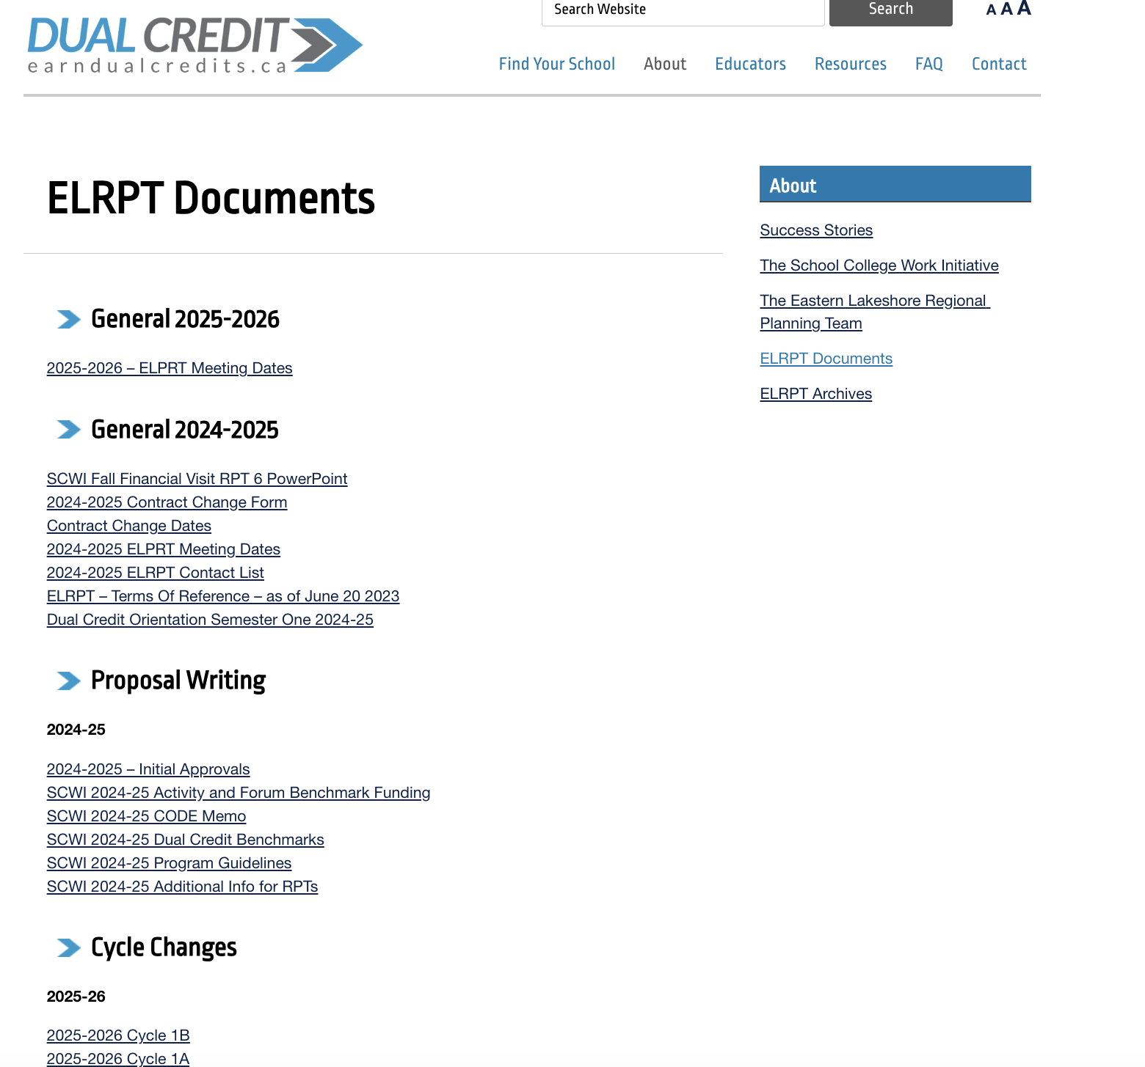

Earndualcredits.ca Website
This the website developed by, and for, RPT6. Grateful to Jon Taylor from Fleming College for his work posting everything on the website.
This site is where students register for their dual credit courses.

Slide 6
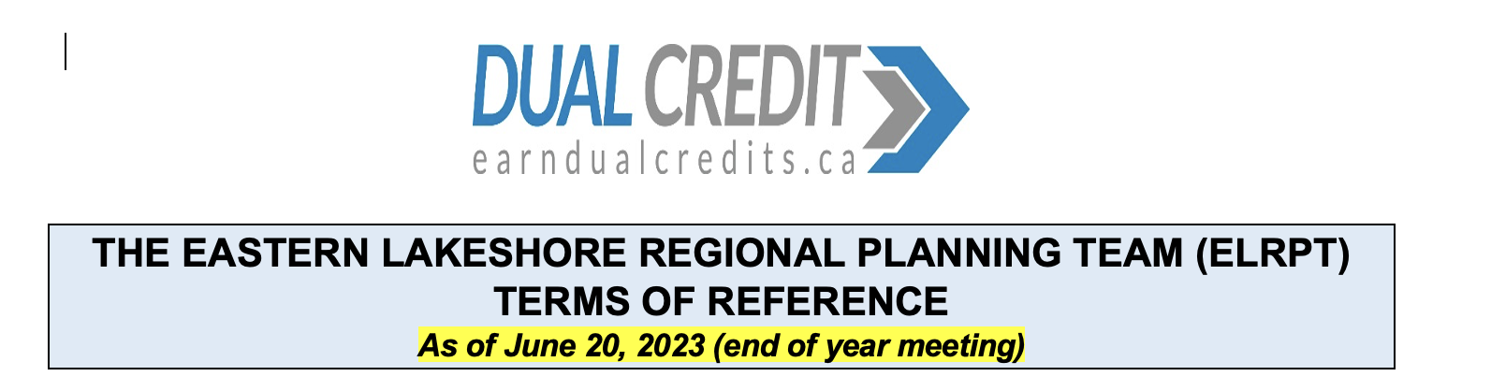
ELRPT Terms of Reference
A guiding document created by the ELRPT that summarizes roles within the RPT, policies and voting processes.
Posted on the earndualcredits.ca website.
During the 2025-2026 school year, we will be updating our T of R to reflect the new realities of the program. Our goal is to review the T of R every year at the June meeting.
When the ELRPT votes on a matter, each of the 8 partners gets one vote. This is a confidential vote. If there is a tie, a second vote is taken. A new tie-breaker process needs to be established.

Slide 7
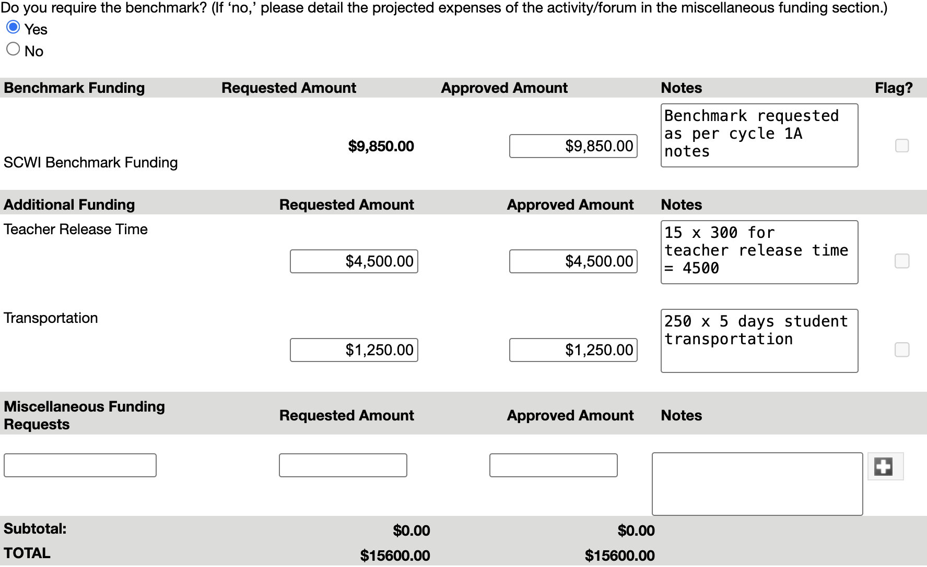
Funding Categories
SCWI provides funding within three categories:
Administration – for funds to cover things like the PA salary, stipend to the FSI, meeting and travel costs, web site maintenance…
Forums and Activities – the ELRPT has 11 forums and activities for the 2025-2026 school year. Funding can be requested on a per-participant basis (funding is $50 per participant), for transportation costs, teacher release and miscellaneous costs. At the end of the year, we must report the actual number of participants and all other costs incurred. This determines the funding received for the forum or activity. Or ‘Estimated vs. Actual’.
Dual Credit Programming – funds to offer dual credit programming (which includes OYAP). There is benchmark funding, transportation funding and miscellaneous funding. Each year, we enter our requests for the following year in Cycle 1A.

Slide 8
Forums and Activities (From SCWI)
Activities and forums should reach beyond college outreach programs currently in place and should have a particular focus on experiences in the skilled trades, technology and apprenticeship. Activities will continue to be:
One-day, hands-on activities for students and accompanying teachers, at the college or secondary school, with first priority to Grade 7 and 8 students, second priority to Grade 9 and 10 students, and third priority to Grade 11 and 12 students.
Activities that promote mentoring for Grade 7 and 8 students by a college student or apprentice.
Maximum of one activity per RPT per college for adult students in Adult Day Schools and Continuing Education Centres to expand awareness of Adult Dual Credits and/or improve transitions for adult students to college and apprenticeship.
Dual Credit Educator Forums for Dual Credit teachers, secondary school teachers, school support staff, and college Dual Credit faculty.
Examples of activities in our RPT:
Loyalist Taste of College Days
KPR/Fleming College Skilled Trades Camps for Grade 7/8 Students
Durham College and Durham Catholic Trades/Tech Camps for Grade 9/10 Students
Durham Building Future Connections with Intermediate Students

Slide 9
Types of Dual Credit Courses/Programs
SWAC – School within a College. In our RPT, these are generally referred to as our Centre for Success program.
Level 1 OYAP – Students doing their Level 1 training through our colleges or a non-college TDA (e.g. Durham Hair Academy, Local 27 Carpentry Union). Level 1 credits end in 4Y.
College Delivered Courses – The college course is taught independently of any high school course, students earn the college credit and a high school credit. The high school course code is established by the Ministry of Education and ends in 4T (e.g. PLK4T).
College delivered courses can be offered at the college, a community setting or at the high school.
Team-Taught Dual Credits – A high school course and college course are taught together at the school by a college instructor and a high school teacher. The college instructor delivers the full college course within the scheduled high school course and students can earn the college credit. The high school teacher delivers the remaining expectations of the high school course and the students can earn the high school credit. Students can pass both courses, one or none.
Benchmark funding is different for each delivery model

Slide 10
OYAP
Approximately 2300 students participated province-wide in the OYAP Level 1 dual credit program.
MLITSD in-class funding is only provided to programs at TDA sites.
Student needs to be an OYAP participant with an RTA.
There were 12 pilot programs throughout the province to offer Level 1 program through Non-College TDA’s. The ELRPT had three of those last year (Carpentry, Hairstyling and Construction Craft Worker).
Non-college TDA’s did not receive funding this year as the funding for the pilot project ended.
The OYAP Level 1 board benchmark is $400 per student.
The biggest expense is transportation. In the fall, OYAP recruiters will need to list their transportation needs for semester 2.

Slide 11
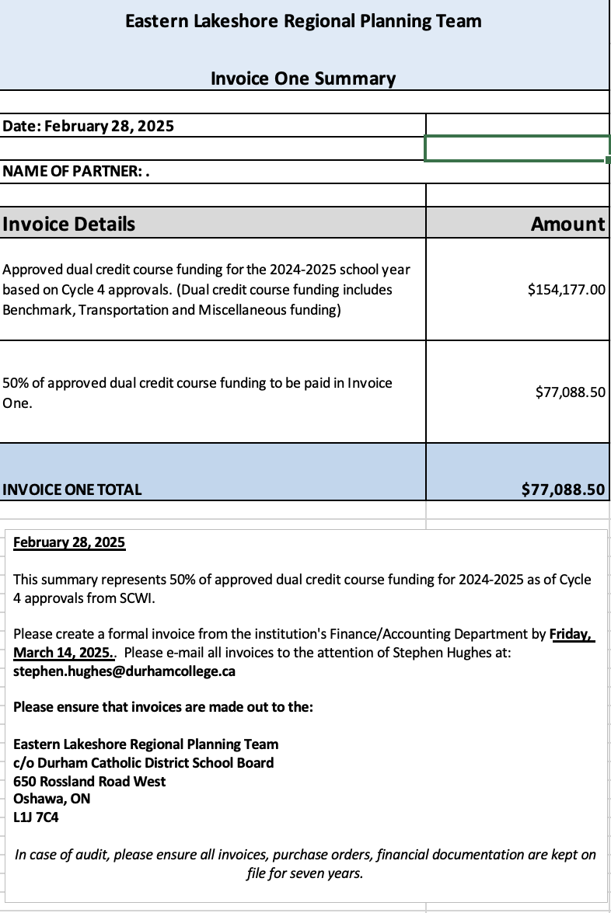
Invoicing
Invoicing refers to the process where school boards and colleges receive funding for dual credit programming (Admin., F and A’s and dual credit courses).
Money flows from SCWI to the RPT via three transfer payments during the year – February (50% of approved funding), May (30% of approved funding) and in September/October of the following school year (the remainder of the actual costs claimed based on end-of-year data).
For the first two invoices, the Program Administator sends each partner an ‘Invoice Summary’ which summarizes the funding to be requested.
The board/college lead will ask their Finance department to generate a formal invoice made out to the RPT’s Financial Services Institution (currently the Durham Catholic D.S.B.)
The FSI will then arrange payment to each institution.

Slide 12
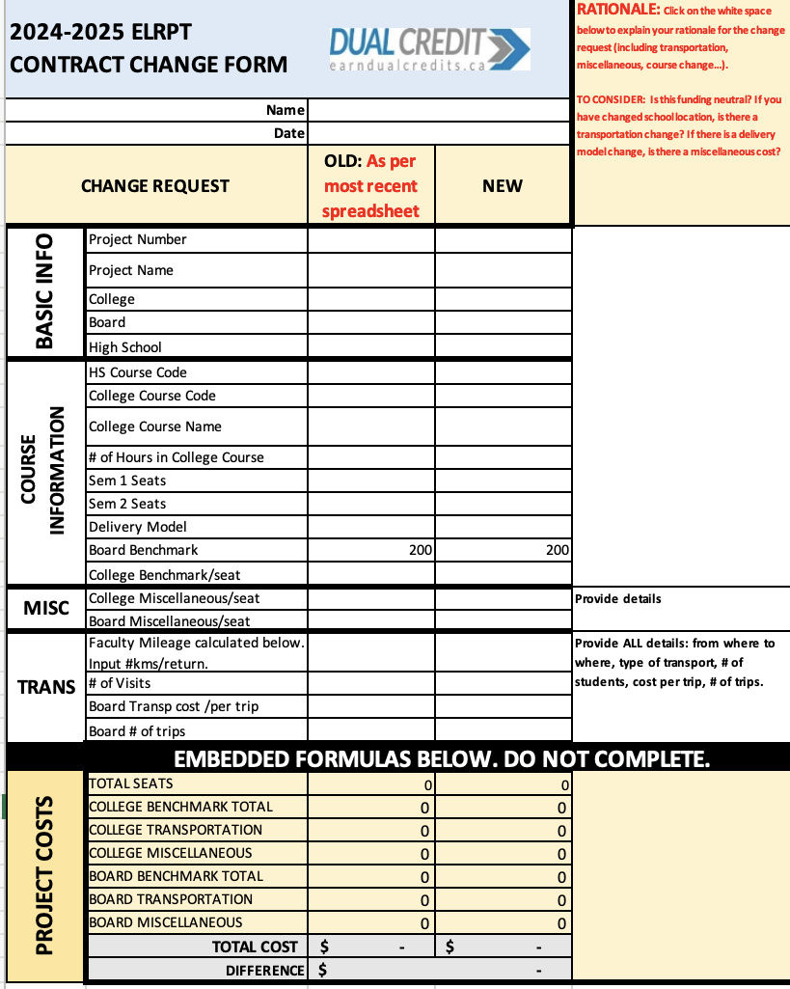
Contract Changes
The term ‘Contract’ speaks to an agreement between SCWI and the RPT on approved programming and funding.
A contract change is a formal application to change something from the previous cycle change approval.
Contract changes are submitted through EDCS by the PA. These can be done in all 6 cycle change periods in the school year.
A contract change can be for a variety of reasons. Some are:
Change details from existing approval (e.g. change in semester, college/high school course code, number of seats requested, funding edits…)
A brand new request or deletion
A movement of a course/seats/funding from one course to another.
The college and school board communicate on each contract change and confirm the details. Once they complete the contract change, it is sent to the PA.

Slide 13
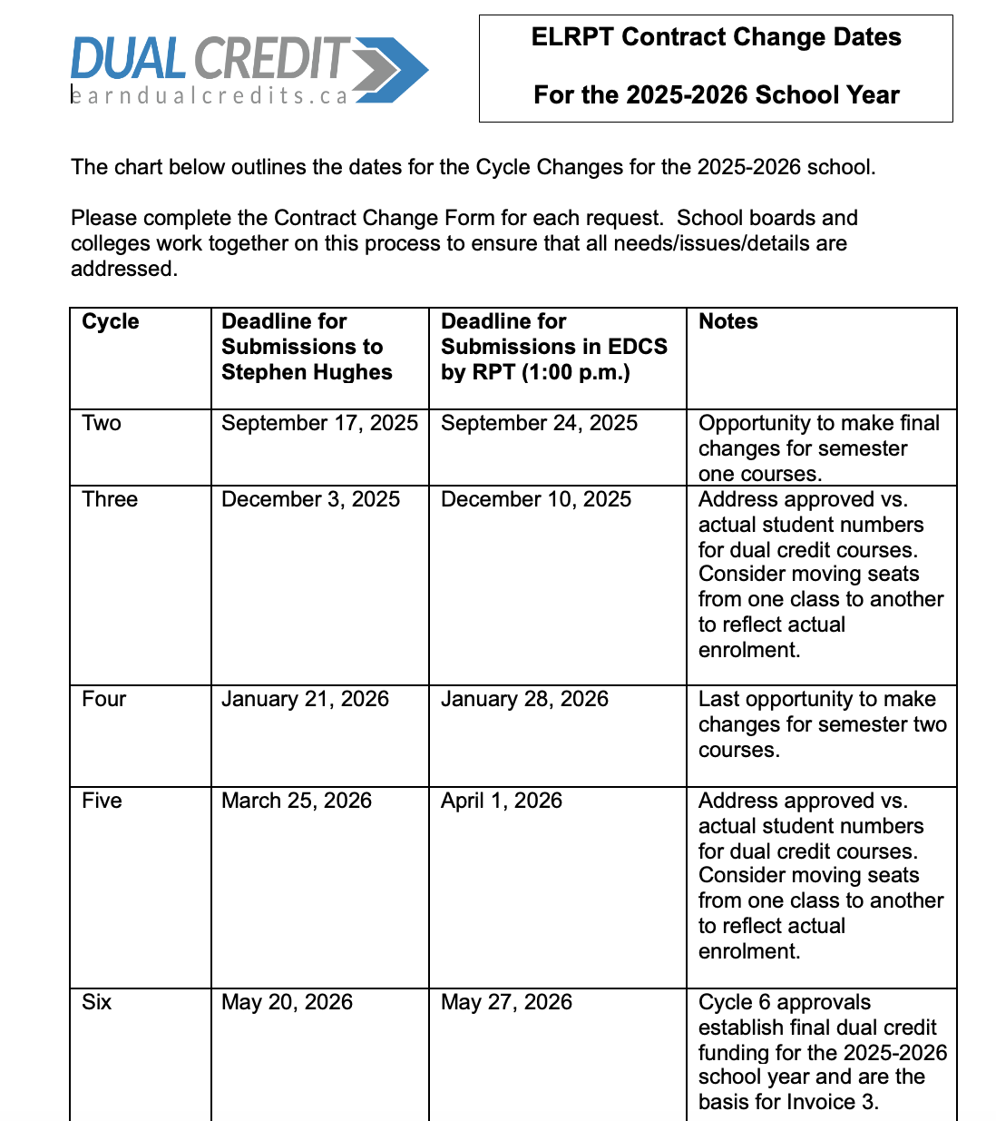
Cycle Change Timelines
Dates for cycle 1A and 1B for 2026-2027 have not yet been established

Slide 14
Planning for 2026-2027
In past years, SCWI used our Cycle 3 approvals of the current school year as the template of approvals for the following school year. Proposals for the following school year were, essentially, changes to cycle 3 from the previous school year.
The template for the new school year has been called ‘Cycle 1A’.
In December, 2024, our RPT adopted a new process where we

