Slide 1
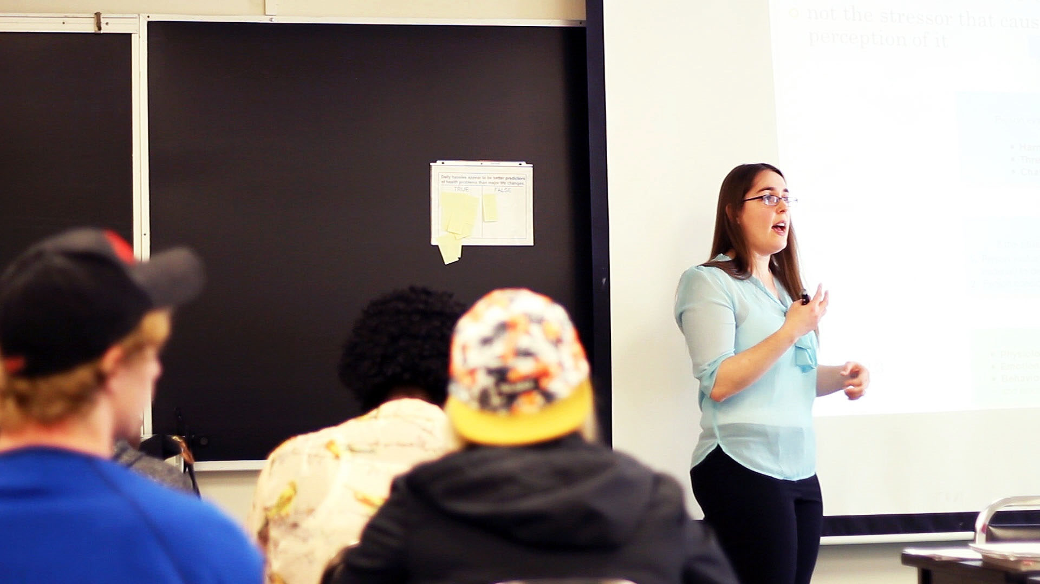
Dual Credit Orientation
Semester One 2024-25

Slide 2
WELCOME AND INTRODUCTION
Regional Planning Team 6
Durham College
Fleming College
Loyalist College
Durham District School Board
Durham Catholic District School Board
Kawartha Pine Ridge District School Board
Peterborough Victoria, Clarington, Northumberland Catholic District School Board
Trillium Lakelands District School Board
Notes:
Sue to welcome everyone
Have everyone introduce themselves

Slide 3
Land Acknowledgement
Notes:
Christine

Slide 4
Part 1 – Focus of the Dual Credit Program

Slide 5
FOCUS
To assist students to complete their OSSD and obtain a college credit. This program includes team-taught dual credits, college delivered dual credits, adult dual credits, the Centre for Success and forums and activities - and more!
Help students make a successful transition to college or apprenticeship programs
The primary focus is on students who are disengaged, underachieving with the potential to succeed in a college or apprenticeship program (refer to Appendix E in Policy Guide)
Students in the Specialist High Skills Major and Ontario Youth Apprenticeship programs are also eligible to participate
Notes:
Christine

Slide 6
Opportunities for SHSM Students
Automatic Reach Ahead Requirement met
Consider: Are there additional specialized skills or training SHSM students exposed to in Dual Credits that would meet certification criteria such as: Advanced Training in Technique, Safety Training etc.
Notes:
Danielle

Slide 7
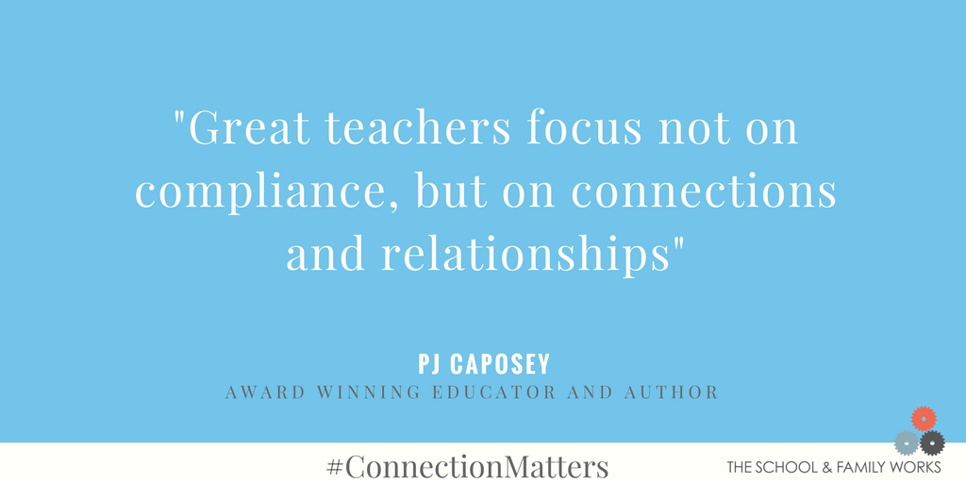
Notes:
Christine

Slide 8
Fostering Student Success through Open Communication
To ensure student success in their dual credit we recommend having frequent conversations with the college faculty
Keeping the lines of communication open throughout the dual credit to address issues such as poor attendance, missed assignments and tests, accommodations, etc.
Supports students' academic success
Addresses challenges promptly
Promotes a positive learning environment
Strengthens the dual credit partnership
Notes:
Christine/Danielle

Slide 9
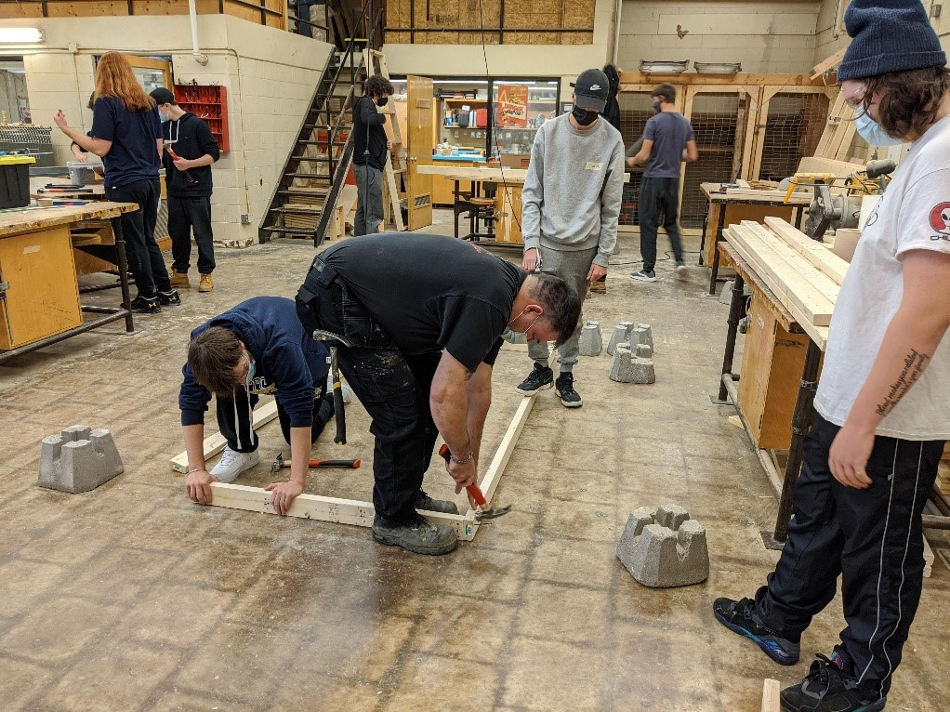
TWO BROAD CATEGORIES
College Delivered
Team Taught

Slide 10
Both the college faculty and the high school teacher are responsible for deciding what assessments and evaluations are going to be used in the students marks and the weighting of these marks
The college course outline defines the college assessments and evaluations, the secondary school portion is flexible
A team-taught dual credit is not two courses that require twice as much work. It is one course taught by two teachers using different perspectives for curriculum delivery
TEAM TAUGHT
-Curriculum and assessment alignment
- Taught by both high school and college faculty
- OSS course code recorded on high school transcript
- College credit recorded as regular college course on college transcript
- Marks can be different on each transcript
Notes:
Sue/Jon/Liz

Slide 11
The college course outline defines the college assessments and evaluations delivered by the college faculty
The college faculty may have some flexibility, depending on the course, with the course sequence, number of assignments, tests, and quizzes.
The principal will record the mark as provided by the college faculty. Grades must not be adjusted
COLLEGE DELIVERED
- College course taught independently as a stand alone course
- College faculty report marks
- Special OSS “4T” course code requested for high school timetable & transcript
- College credit recorded as regular college course on college transcript
- Must be a minimum of 42 hours; 3 hours per week
- Secondary school teacher provides support with IEPs, teacher conversations, technology, etc.
Notes:
Sue/Jon/Liz

Slide 12
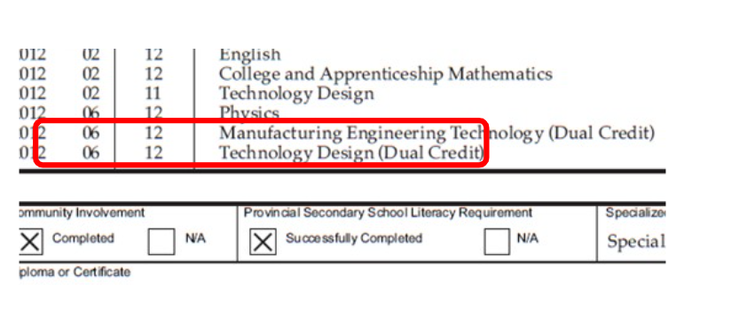
TEAM TAUGHT DUAL CREDITS RECORDING COURSE CODES AND CREDITS
Credit for the secondary school course is recorded on the OST using the code for the secondary school Ontario curriculum course
College credit recorded on the college transcript
Marks are often different on each transcript
Notes:
Sue/Jon/Liz

Slide 13
Part 2 – Important Stuff to Know

Slide 14
STUDENT REGISTRATIONS
Secondary school teachers/students are responsible for completing registrations on the Earn Dual Credit website
Registrations are not real-time and can take up to a week to process. We will make every effort to process all applications as quickly as possible
Students will not have access to the college Learning Management System with their course content until their registrations have been processed by the college
As many scheduling changes occur during the first few weeks of the semester, please compare your class list with your college faculty’s class list to ensure that no students have missed registering or students that have been removed from the class are not showing on the class list
www.earndualcredits.ca
Notes:
Sue/Jon/Liz

Slide 15
STUDENT WITHDRAWALS
If you have students who stopped attending within the first 10 days of the start of the dual credit, please let the college know so they can drop/delete the student record so nothing shows on their college transcript
Students must complete a formal withdrawal form to withdraw from the dual credit
All withdrawals must be received on or before the withdrawal deadline to be recorded on the transcript as a “W”
Any withdrawals received after the deadline will not be processed and the final mark will stand on the student record
Withdrawal Deadlines:
Week 10 (60% of course completed) – 42 hour*
Week 14 (60% of course completed) – 56 hour*
*Colleges will send an email reminder of all deadline dates. Please check your emails frequently!
Notes:
Sue/Jon/Liz

Slide 16
Learning Management Systems
Where college faculty create and organize course content, including lectures, assignments, quizzes, and multimedia resources
Facilitates communication with students through announcements, discussions, and messaging
Tracks student progress and performance
Please encourage students to log into the LMS as soon as they have access. Log-in instructions were included in the introductory email you received from your college
The college faculty will provide an overview of the LMS
Notes:
Sue/Jon/Liz

Slide 17
CAMPUS VISITS
All team taught dual credits will visit the college once during the semester
At the beginning of the semester please meet with your college faculty to select a date for the visit. Please note that colleges may have limited dates available. Book early to avoid disappointment!
College faculty will connect with the college to book the campus visit
It is the responsibility of the secondary school teacher to arrange transportation to the college*
Each college offers a unique set of activities and choices during their on-campus visits. Please check with your college faculty for the available options
*TLDSB’s dedicated dual credit teacher is responsible for booking any TLDSB class visits to the college
Notes:
Sue/Jon/Liz

Slide 18
Dual Credit Transfer Guide
TRUTH OR MYTH?
Any dual credit can transfer to any
program and any college in Ontario?
Dual Credit Transfer Guides
https://flemingcollege.ca/dual-credit
https://loyalistcollege.com/future-students/credit-transfer/
https://durhamcollege.ca/academic-faculties/faculty-of-liberal-studies/services/scwi/dual-credit-transfer-guide
Notes:
Sue/Jon/Liz

Slide 19
Overall Benefits of the Dual Credit Program
Benefits of taking a Dual Credit
Increased confidence in student’s ability to be successful in a college course/apprenticeship
The trip to the college allows students to be on a post-secondary campus – for many students, this may be their first time on a campus
Dual credit course may be used towards admission to college
Increased awareness of career/education opportunities
Familiarity with a college Learning Management System
Teachers have spoken about the benefit of working with college faculty, learning about college curriculum and getting new ideas that they can incorporate into their high school course. A great type of ‘Professional Development’
Notes:
Christine

Slide 20
Board Contacts for Dual Credits
Claudine Longo- DCSB Claudine.Longo@dcdsb.ca
Krista Parker- DDSB krista.parker@ddsb.ca
Danielle Moher - KPRDSB danielle_moher@kprdsb.ca
Johanna Denley – PVNCCDSB jdenley@pvnccdsb.on.ca
Christine Moore - TLDSB christine.moore@tldsb.on.ca
Board Leads are the liaisons between school boards and the colleges. If you are unable to resolve an issue with your college instructor, or would like more information about dual credits, please reach out to your board contact as opposed to contacting the colleges directly.
Notes:
Christine

